Slide 1
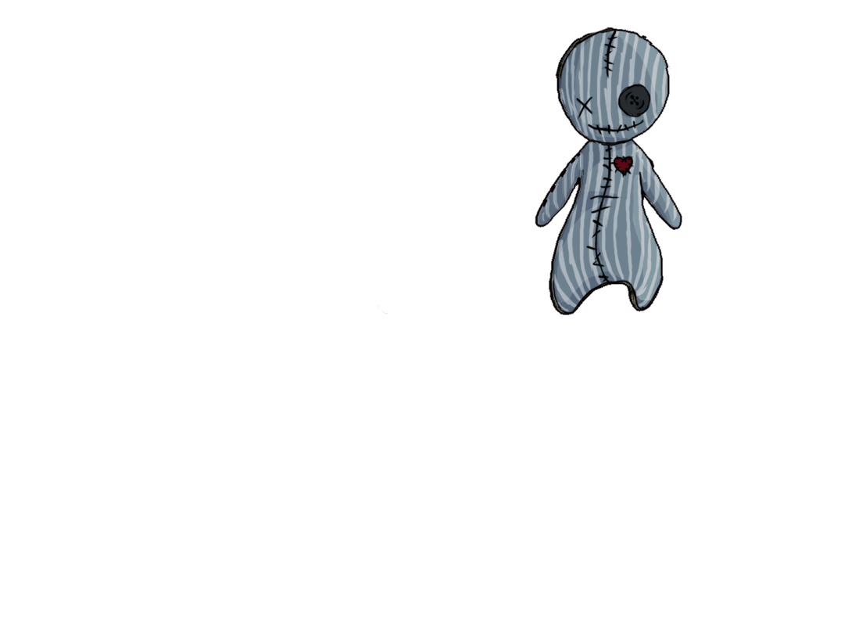
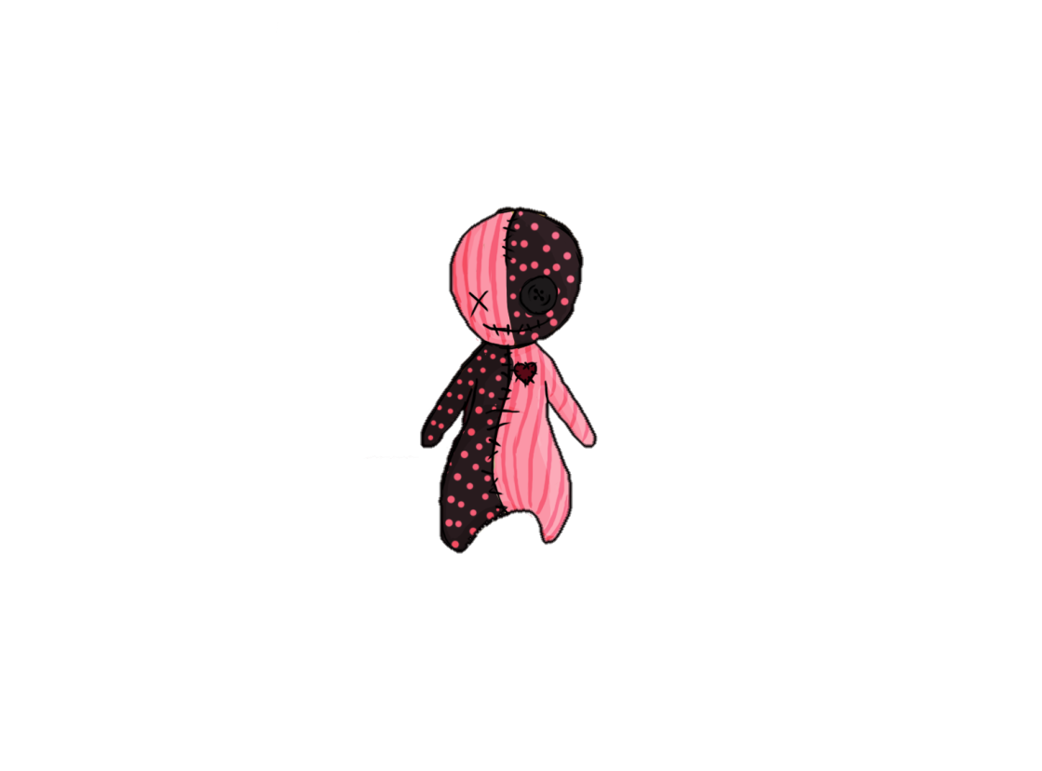


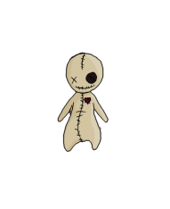
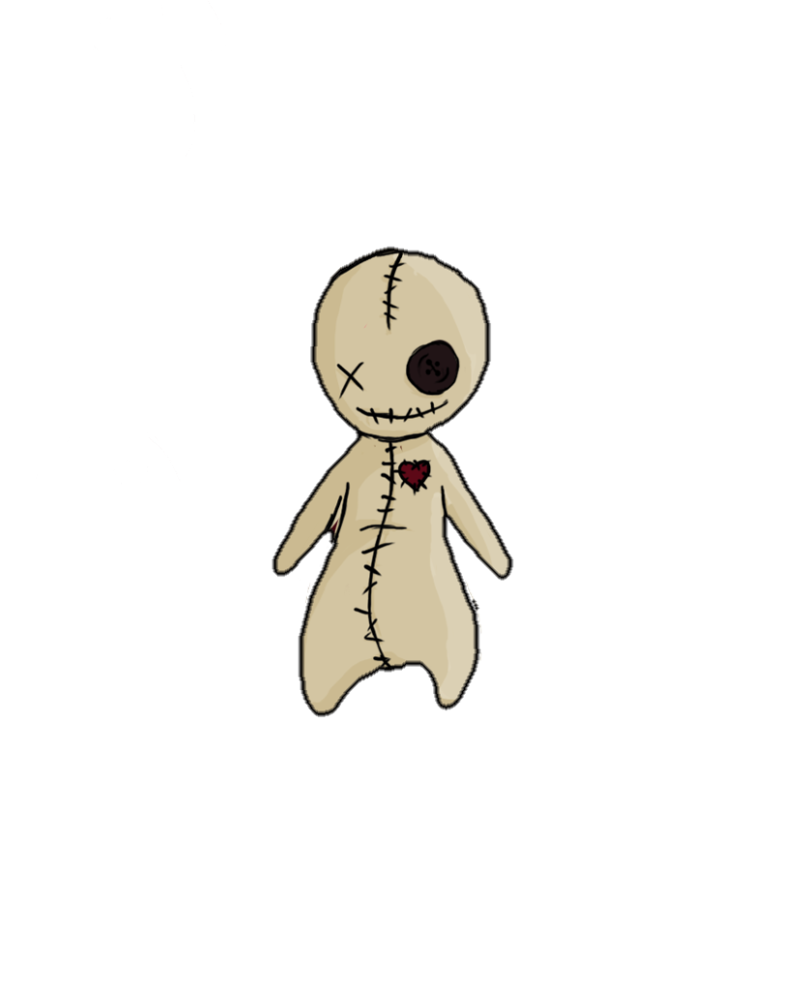





Doll 13
by
Notes:
Hello and welcome to the Goldmaster presentation of „Doll 13“ made by Team Rex.

Slide 2

Table of Contents
Review
Team Rex
Gate 3 Promises vs. Present
Let’s Play!
Questions
Notes:
First I will give you an overview of what you will see today:
Since many of you don’t know the game at all, I will start with a review of our vision and give you some basic information about the game itself.
After that I will present you the team that made all of this possible and give you a quick overview of what each of them contributed to the game.
Afterwards we will see the goals we had for today and check if we were able to fulfill them and then we will directly dive into the game.

Slide 3
Review
Vision: Doll 13 is a 3D puzzle-adventure for lovers of the occult with minimized stealth-elements.
Game Type: 3D Platformer
Game Mode: Singleplayer
Genre: Supernatural Adventure
Platform: PC
Engine: Unity
Notes:
Doll 13 is a 3D puzzle-adventure for lovers of the occult with minimized stealth-elements. We tried to create a game where you can explore everything at your own pace and where you have to take a look around to be able to grasp the whole story. It’s a singleplayer game for PC where you play a little Voodoo-Doll that came alive in the basement of a secret base and now trys to escape from there.

Slide 4
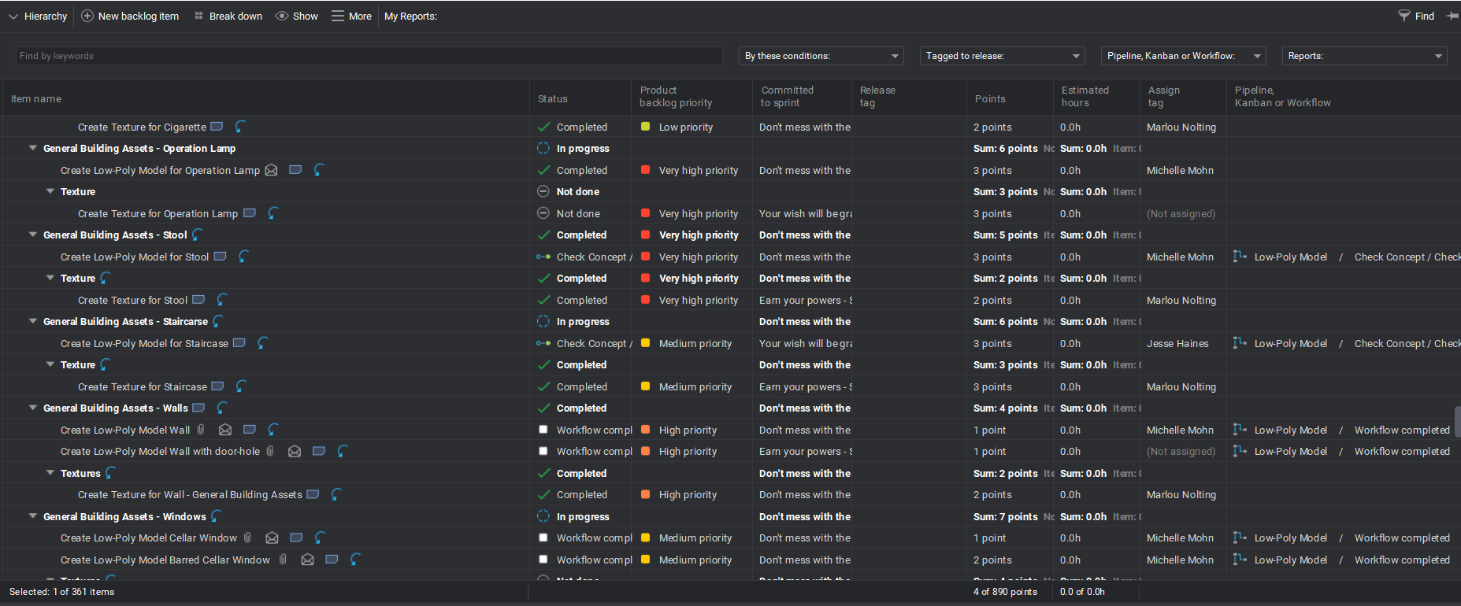
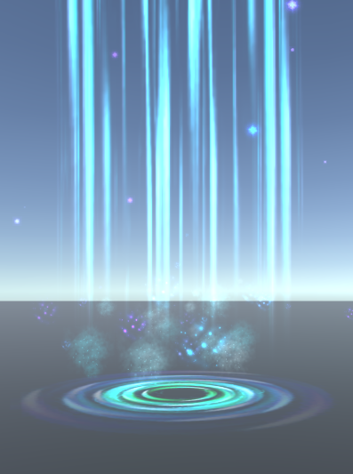

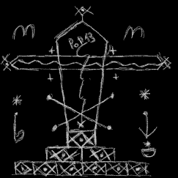
Team Rex
Producer:
Sonja Köck
Programmer:
Artjom Schmitke
Game Designer:
Tobias Schuster
Sound Designer:
Elias Knop

Slide 5
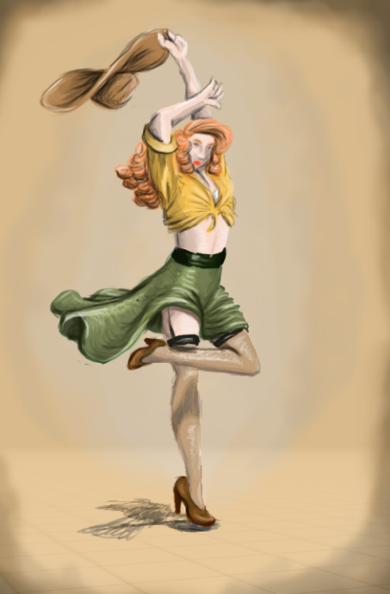
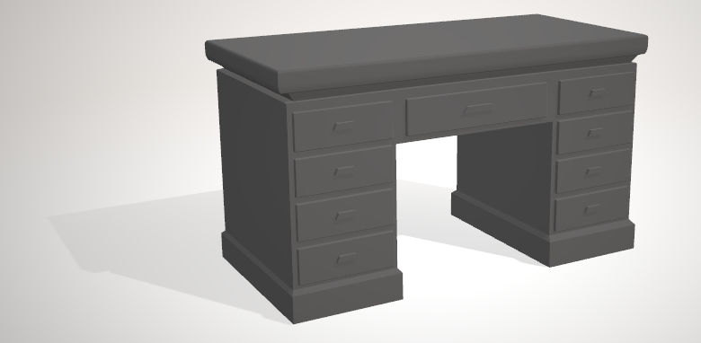
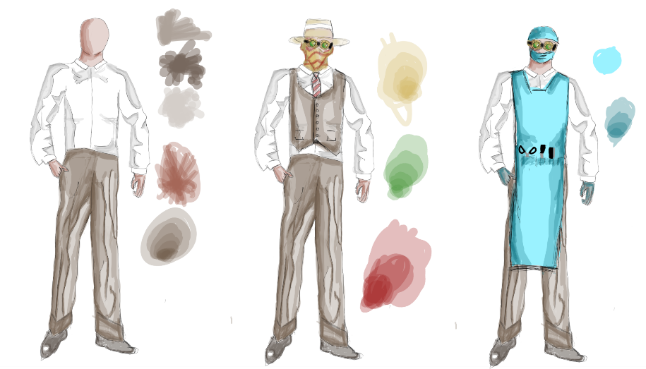
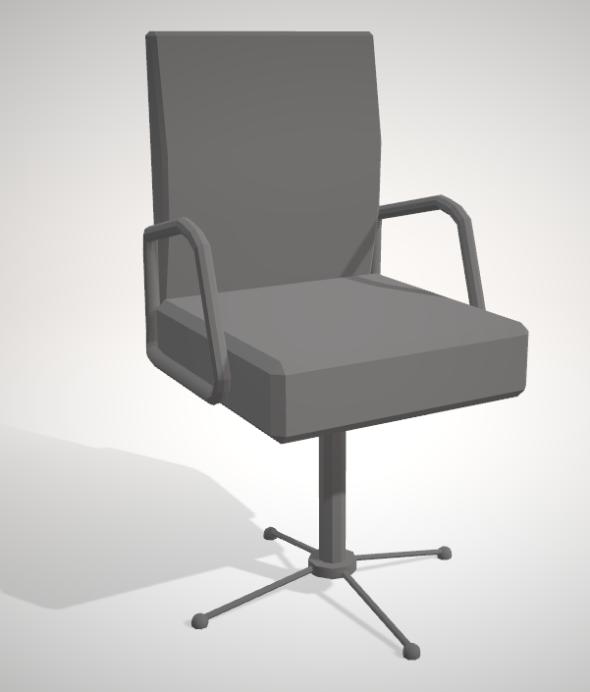
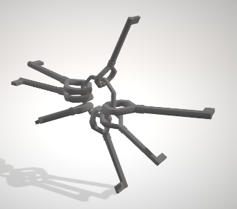
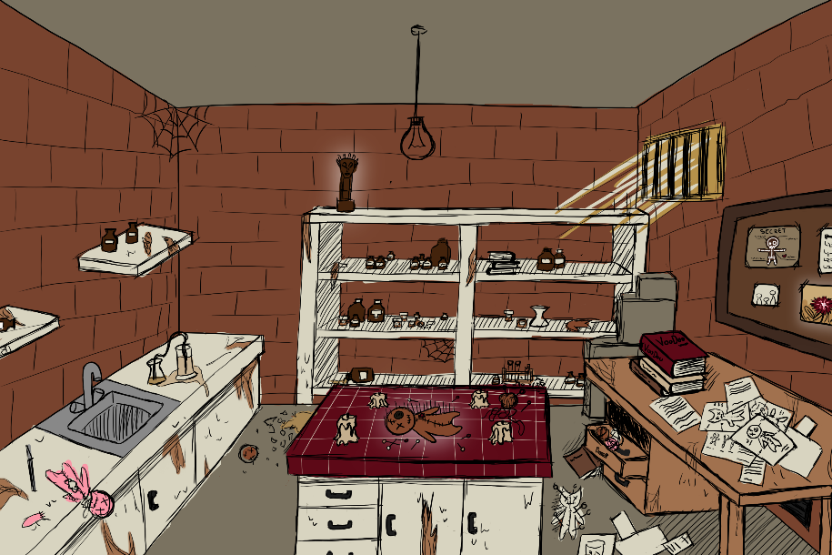
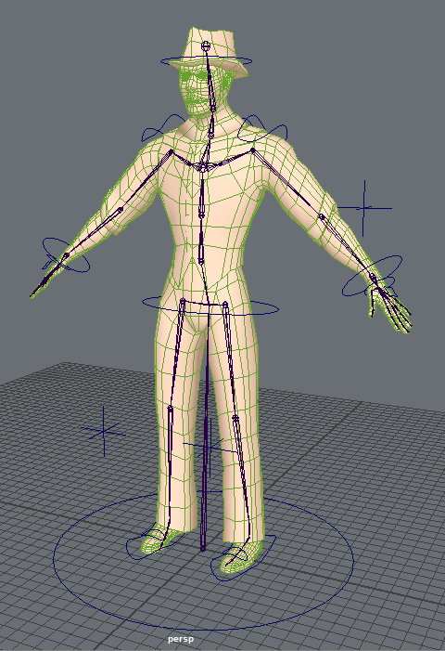
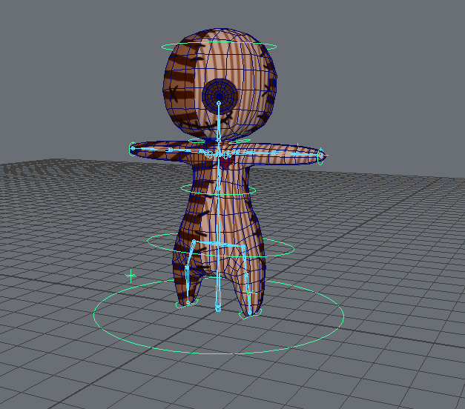
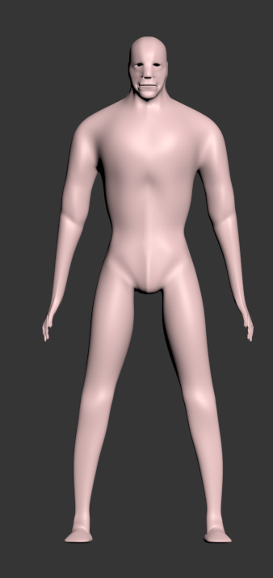
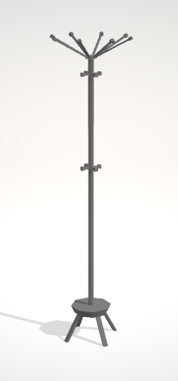
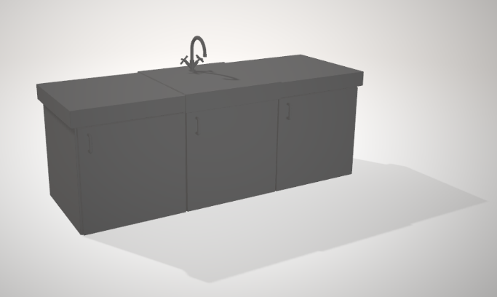
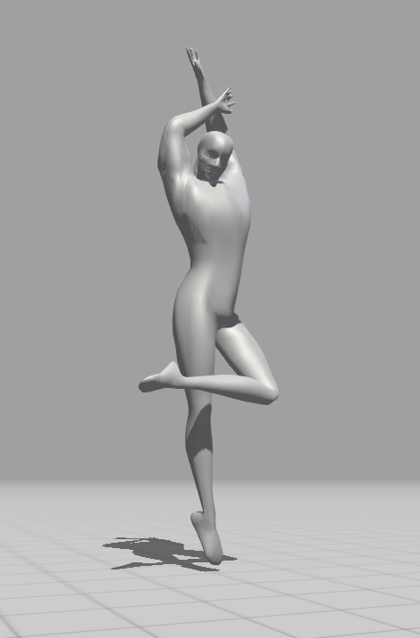
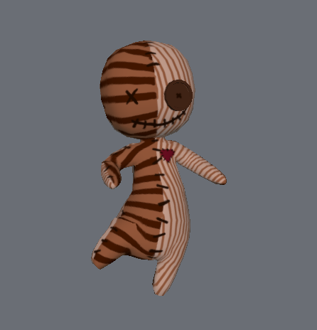
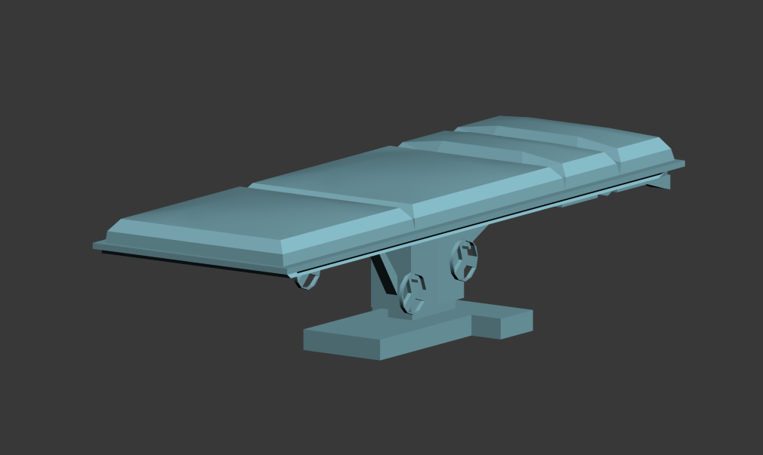
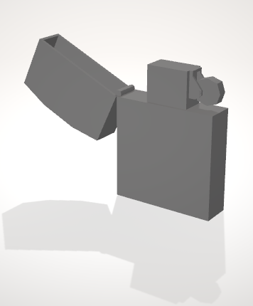
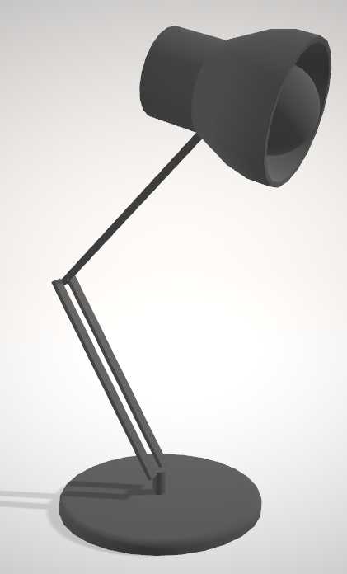
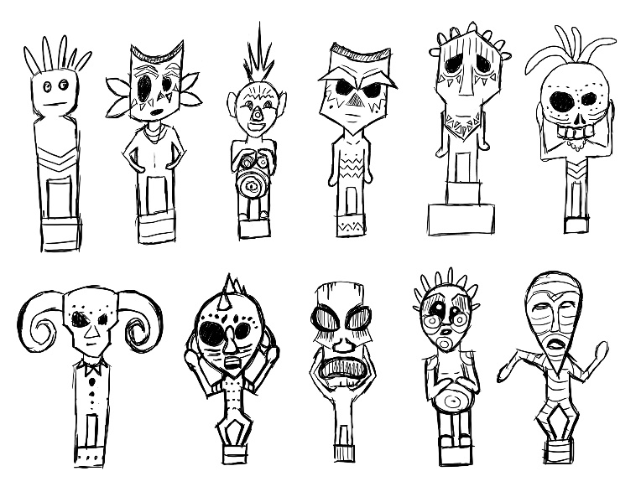

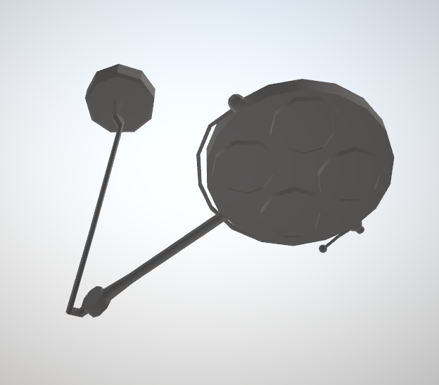
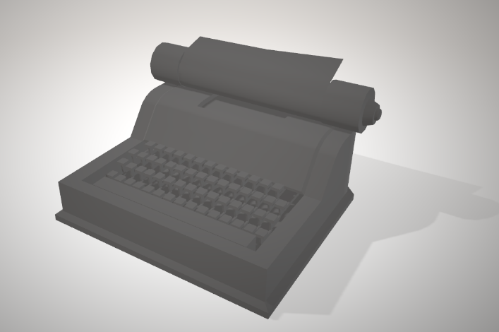
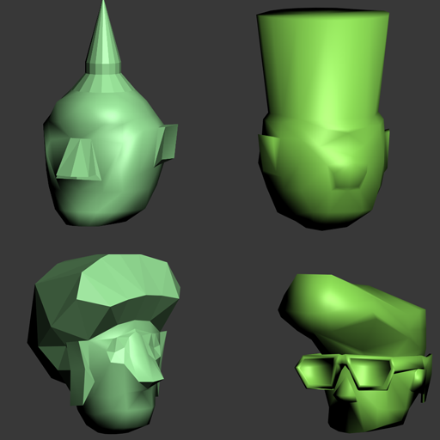
Team Rex
Artists:
Michelle Gaußmann
Jesse Haines
Levin Lang
Michelle Mohn
Marlou Nolting
Notes:
So, lets get to the main part of our team: our artists! Michelle Gaussmann is our animator. Not only did she make the skin, rig and all the animations of our main character…
… she also made a retopology of the guard model, skinned and rigged it and made all the animations for it as well. Since our guard has some really nice legs she also decided to use him as a model for some posters she made for the game.
Jesse Haines is our 3D-Specialist for some of the more complex 3D-models in the game
Levin Lang is our jack-of-all-trades. He provided us with various concepts throughout the production, created the basic body of our guard as well as several 3D assets and decals and also made some small animations for the game.
Michelle Mohn also is very flexible regarding 2D and 3D. She made some nice concepts for our tutorial room and our fetish but mostly created the tons of 3d assets that you can see everywhere in the game.

Slide 6

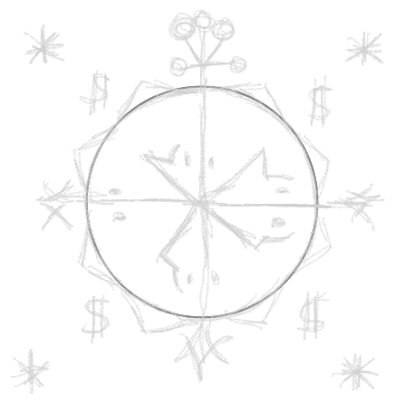
Gate 3
Promise:
Present:
Tutorial
Menu
Polished Game

Slide 7


Let’s play!

Slide 8

Any Questions?
Team-Rex
Games Academy Frankfurt
Hanauer Landstraße 146
60314 Frankfurt am Main
Sonja.Koeck@games-academy.de

